Slide 1


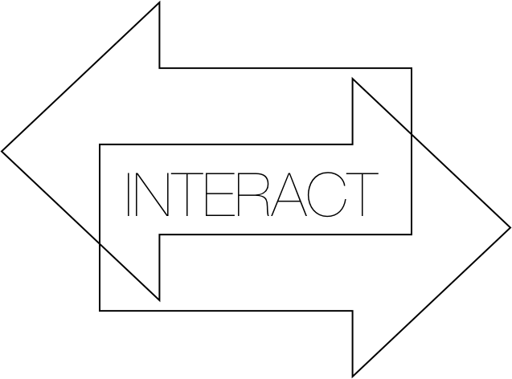
Team2
Marianna Hatzidemetriou
Agathe Duboue
Anastasia Yiannaki
Sotia Gregoriou

Slide 2
Project Goal And Approach
Web Application for Professors and Students
Interactive lecture
Minimal design :
Easy to use
Easy to navigate
Easy to remember
Students test their knowledge
Questions/answers created by professor

Slide 3
Project Goal And Approach
Professor can add, edit and delete a question or an answer at anytime
Logins for each professor
Course code for student access

Slide 4
Technologies used
Technologies learnt in this course
HTML and CSS (website design)
PHP and Javascript (website operations)
Mysql (database management)
Xampp (working locally with no servers)

Slide 5
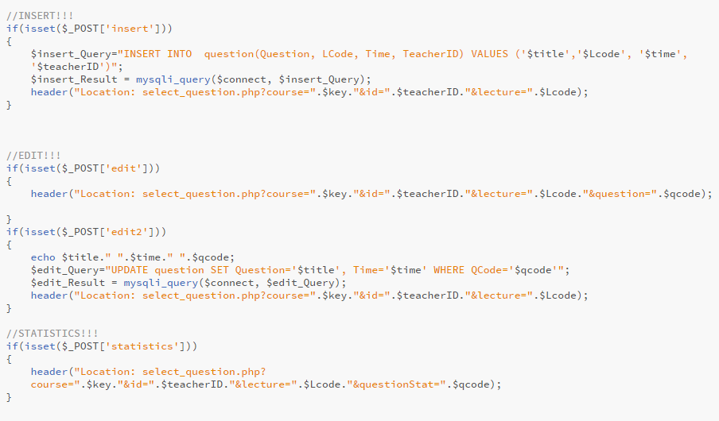
PHP – complexity sample code

Slide 6
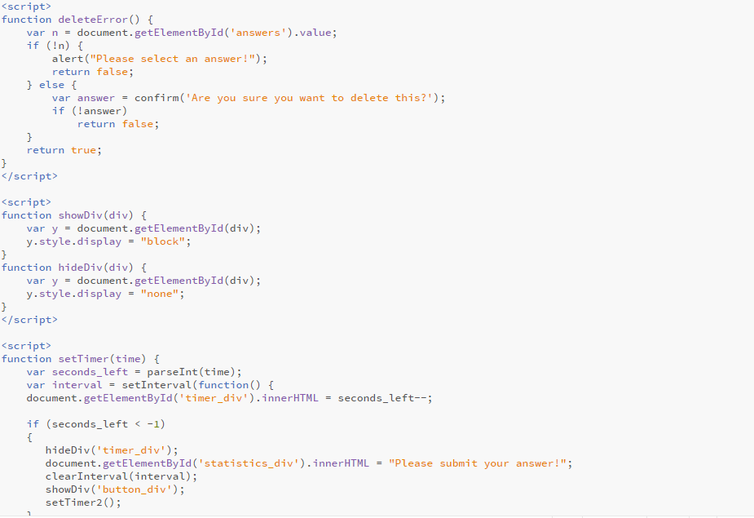
Javascript – complexity sample code

Slide 7
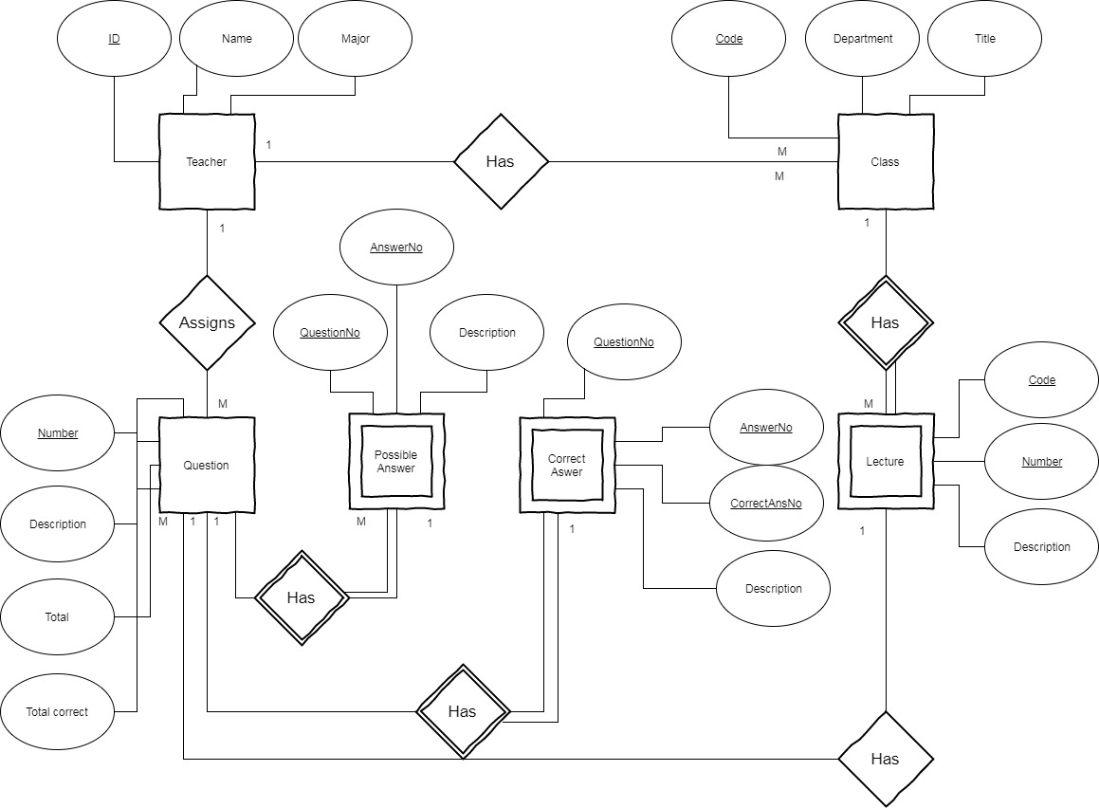
MySQL
Entity Relation diagram used for constructing our database
Each student is enrolled to some lessons
Each professor has some classes
The professor assigns questions
Each question has some possible answers
And each class has lectures with questions
The student chooses an answer from the possible ones.

Slide 8
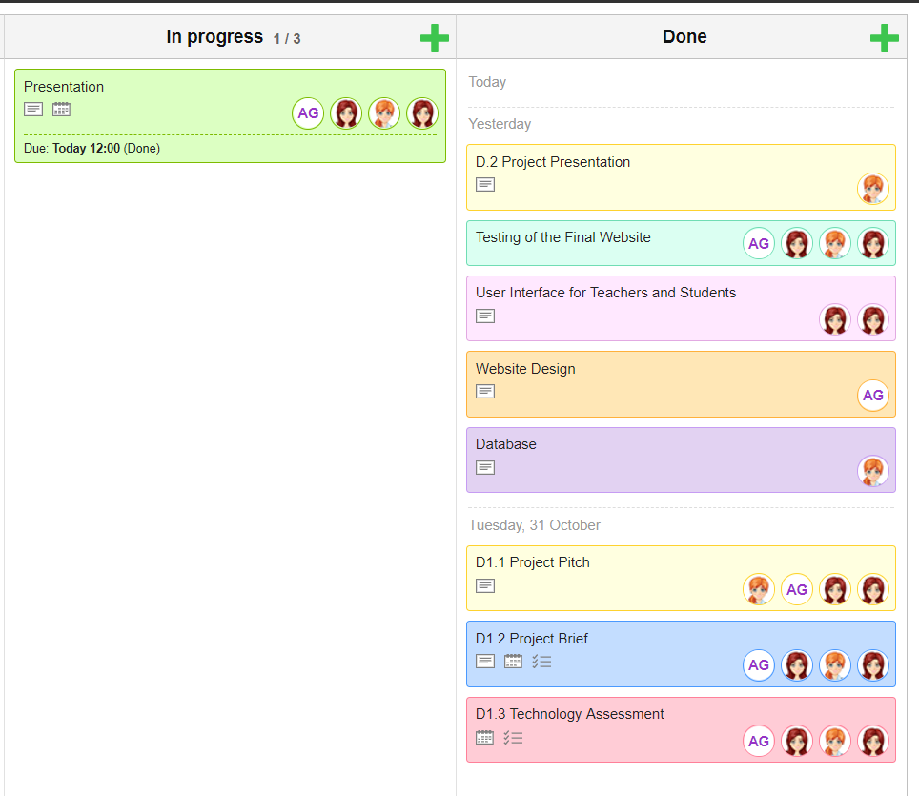
Timeline and Communication
KanbanFlow used to organize website creation
Timelines for each task
Individual work on some tasks but also group work on others
Helped us achieve basic project goals

Slide 9
Achievements & Evaluation
Principles of usability learnt in the course
Easy to learn
Efficient to use
Easy to memorize
Few errors
User friendly

Slide 10
Easy to learn
Buttons with labels for easier user navigation
Simple structure and design
Not too much functionalities
Very specific scope:
Students choose course and lecture, then answer to questions within limited time
Teachers add, edit & delete questions

Slide 11
Efficient to use
Performing & functioning, no waste of time and effort
Figure out quickly how to use it
Understand fast the functionalities
Not too many pages redirection
Change what users see with dynamic programming (javascript and php)

Slide 12
Easy to memorize
As web app quite simple, easy to learn -> easy to memorize
Specific background and logo
Website unique and memorable

Slide 13
Few Errors
Avoid any kind of errors in the code
Test of every functionalities in all possible cases
Thanks to Google we overcame every problem we faced!

Slide 14
User friendly
User is the most important part of project
He the one to test it
If he likes it he will use it

Slide 15
Conclusions
Best web site ever
You should use it all the time
It’s really nice looking

Slide 16

Thank you for your time, any questions ?

